Slide 1

Unbeatable Website on a Pi: A Self-Adaptive Approach
Group 7 – Arthur Li, Daniel Almeida

Slide 2
Problem Statement
Key Issues
Downtime
Inefficient resource allocation
Manual labor
Implications
Reduced user confidence
Operational Costs
Overprovisioning
Unrealized potential
Motivation
Remote location
Weather impact
Resource constrained

Slide 3
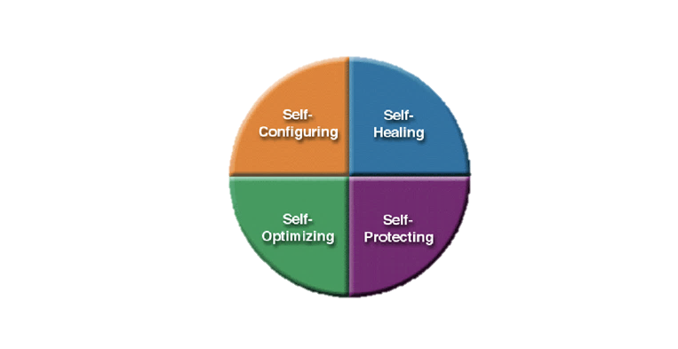
Proposed Solution
At its core: A self-adaptive web hosting framework
Framework: MAPE-K (Monitor, Analyze, Plan, Execute, Knowledge)
Mechanisms:
CPU clock speed adjustments
Content degradation
Watchdog timer
Apache caching
Anomaly detection model

Slide 4
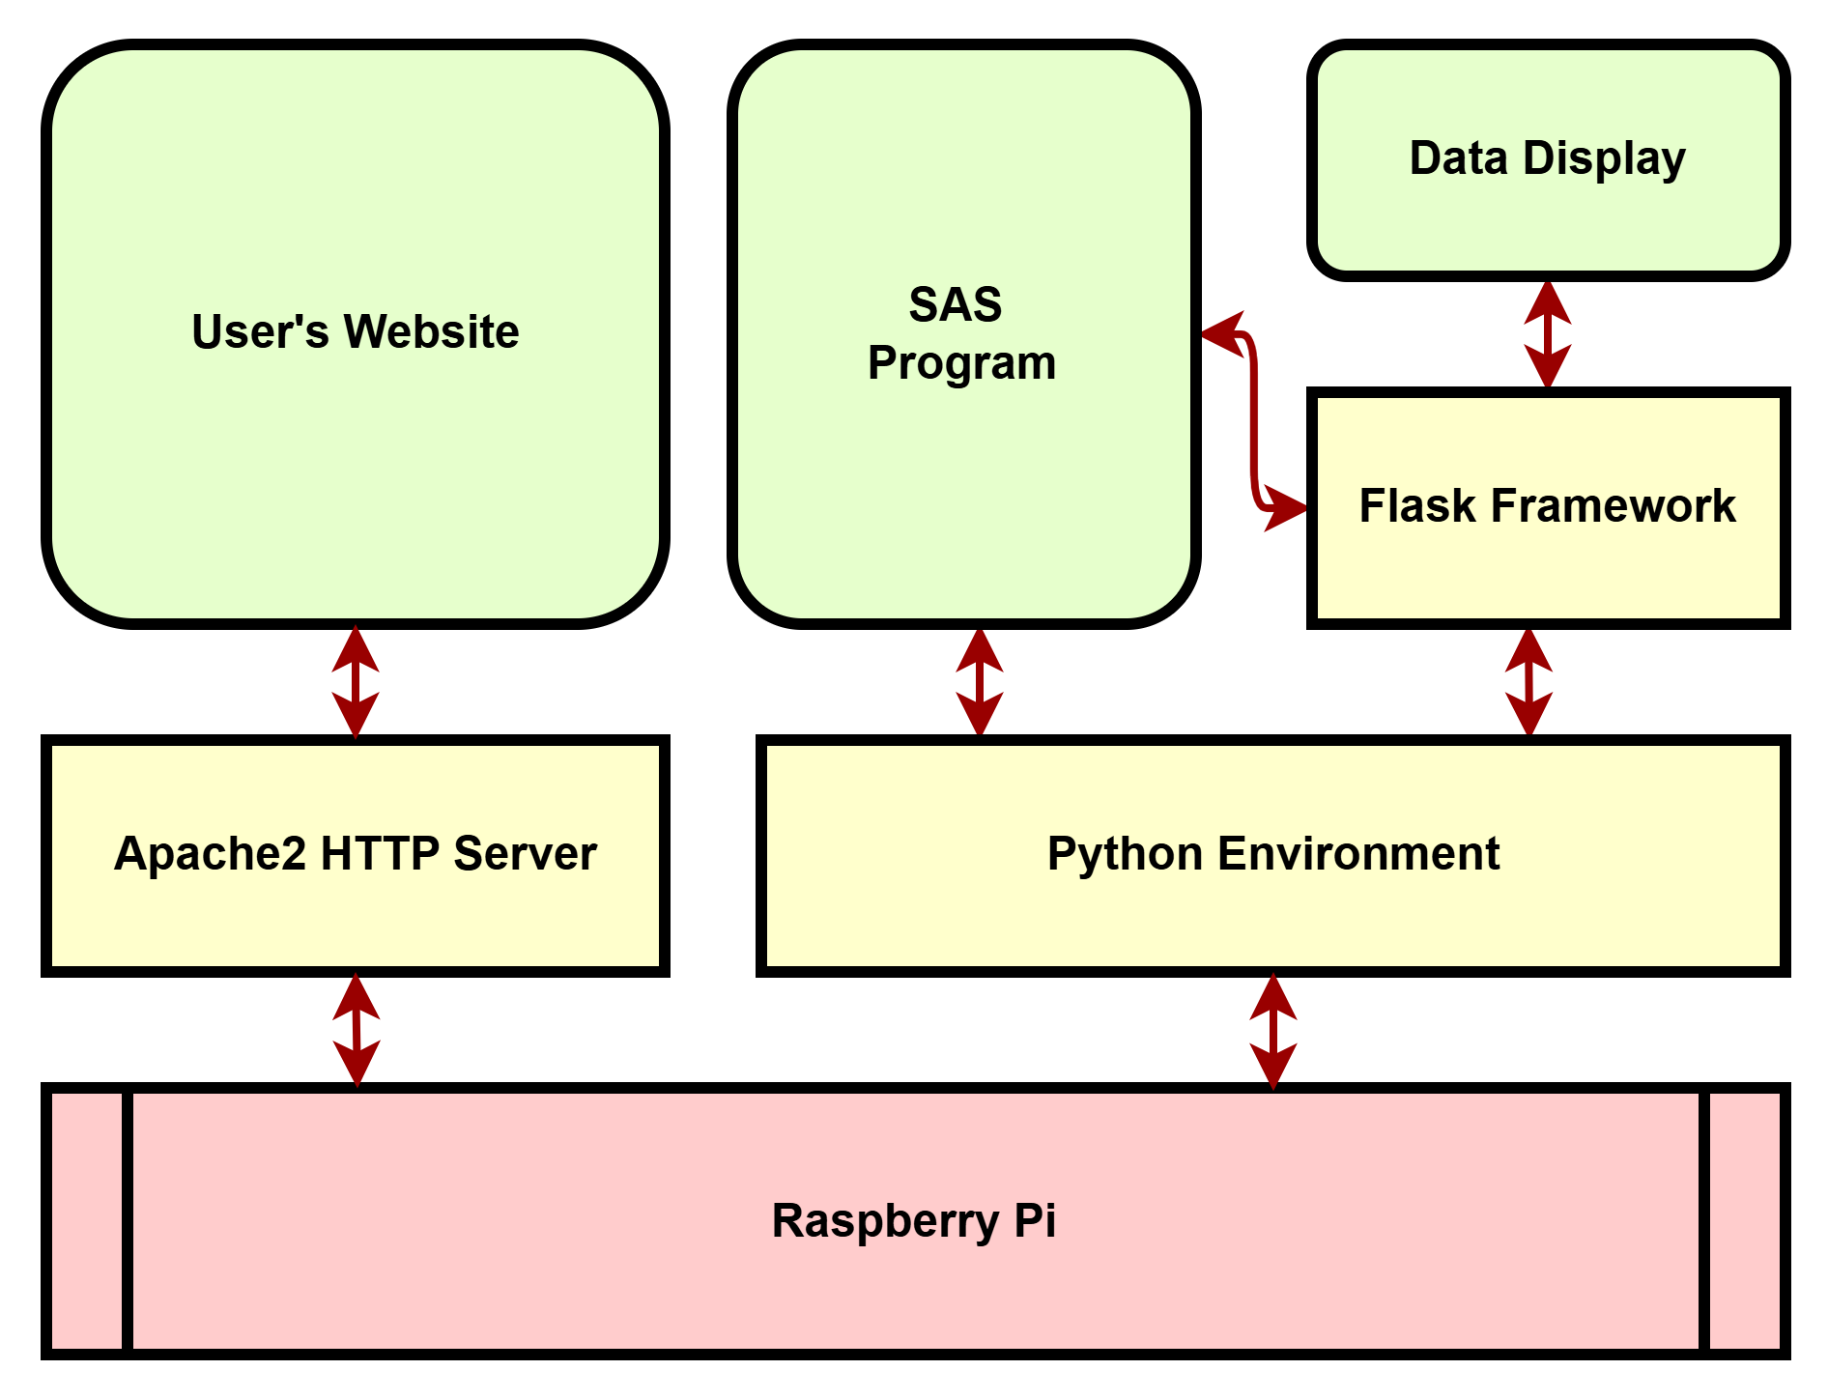
Proposed Solution
Hosting and Server
Apache HTTP Server
Flask
Shutil
Requests
Programming and Frameworks
Python
Threading
Joblib
Monitoring/Metrics
Psutil
Testing/Validation
Jmeter
Syslog
Scikit-learn
Data Analysis
Pandas, Scikit-learn (OneHotEncoder), StandardScaler
External
OpenWeatherMap API

Slide 5
Proposed Solution

Slide 6

Proposed Solution
Isolation Forest model integration with real-time monitoring daemon
Pre-processing
Hyperparameters: n_estimators, contamination, random_state

Slide 7
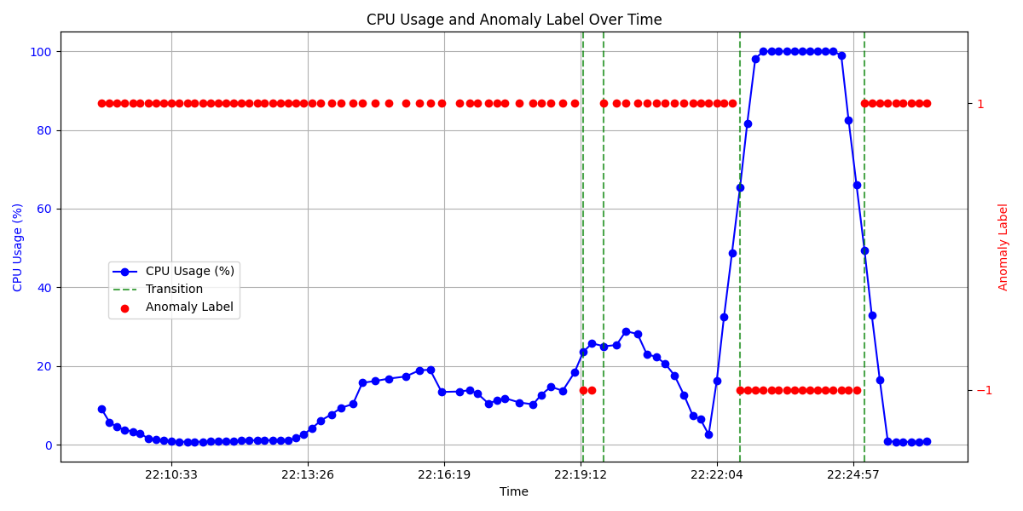
Outcome

Slide 8
Outcome
Adaptive framework improves RPiWeb hosting
Dynamic adaptation optimizes performance and system stability under fluctuating traffic loads
Automatic reboot mechanisms ensure minimal downtime and uninterrupted hosting
Optimal thresholds reduce content oscillation and enable efficient resource allocation

Slide 9
Challenges and Future Work
Challenges
Weak model due to data
False-positives
Verbose implementation
Hyperparameters
Future Work
Scaling for different use cases
Minimize historical data required for initial setup

